Slide 1
Henderson High School
Shed Build Project
Delivered by
Department of Building Technology
Unitec

Slide 2
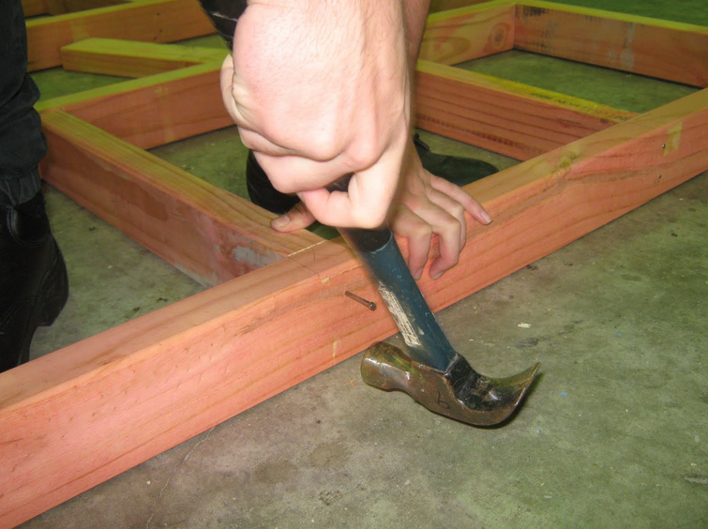
A group of 15, year 12 High School students become Unitec students for 10 days.
An initiative designed to provide a Smoother Transition to Tertiary Education.

Slide 3
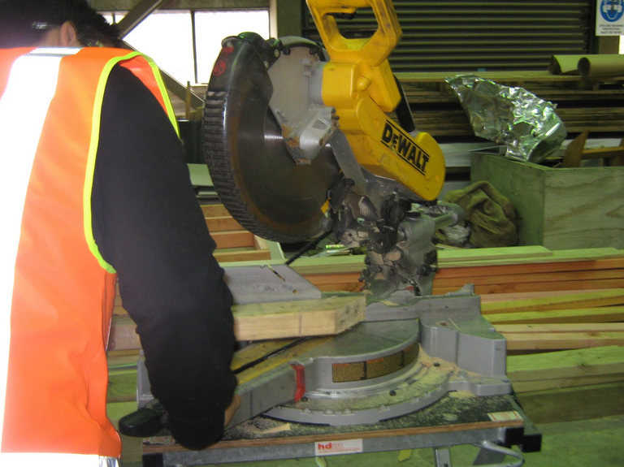
High school students Attend Unitec and complete unit standards based learning projects that have both a practical and theory component

Slide 4
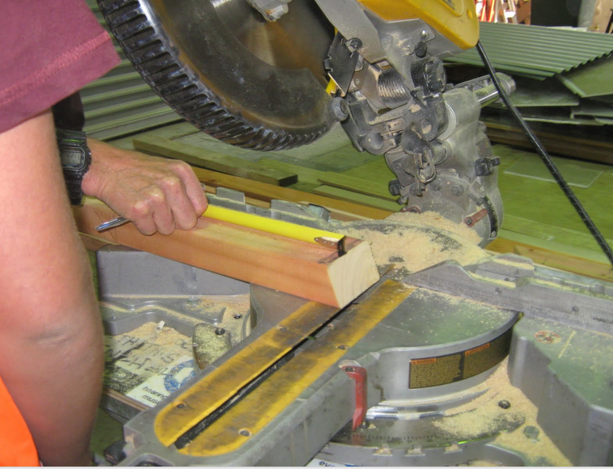
Future course duration will be 2 days per week for 10 weeks or one term.

Slide 5
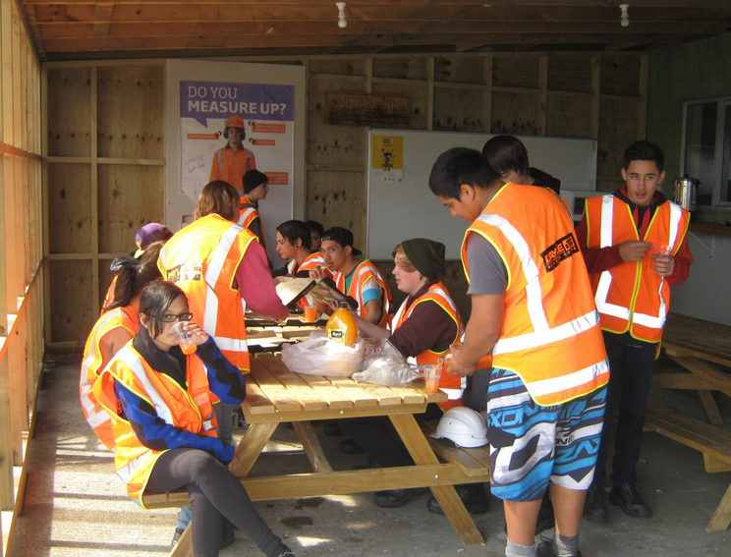
Students gain between 20 and 25 level 2 and 3 unit standard credits

Slide 6
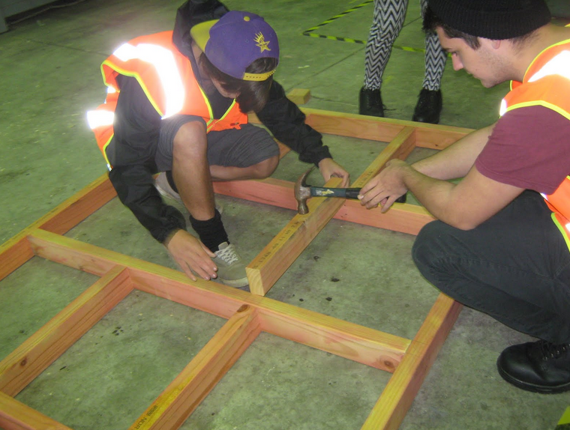
Students become familiar with a tertiary environment.
Why do this?
While they are with us they visit departments and courses that interest them.
Students can become disengaged in years 12 and 13 in a school environment that they feel they have outgrown.
Unitec offers new social and challenges as well as a new learning environment with adult expectations.
v
Students choose a future study path with real insight into what is involved in a tertiary study course.

Slide 7
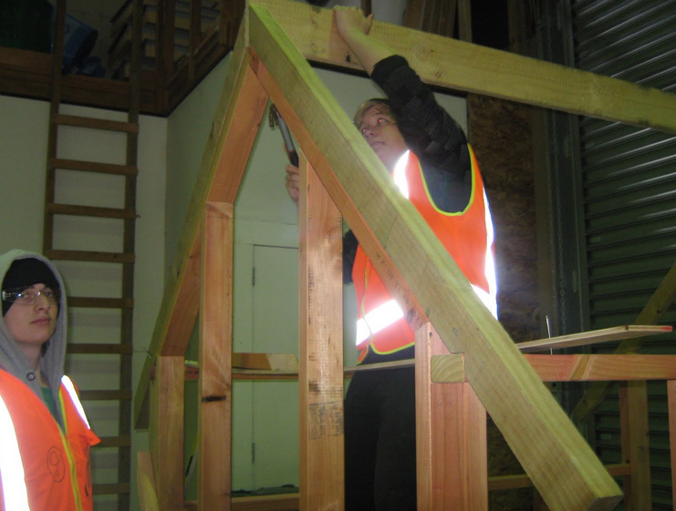
What the school said
Some students were noticeably more focussed and engaged on returning to school. 3 of the 15 students enrolled in the CAT Carpentry course for the following year.

Slide 8
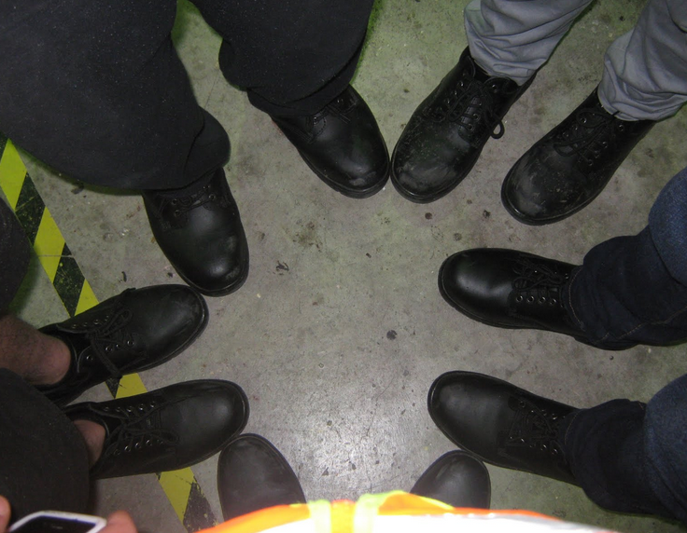
Funding
Students receive funding through the Star programme which can make the exercise cost neutral for the school

Slide 9
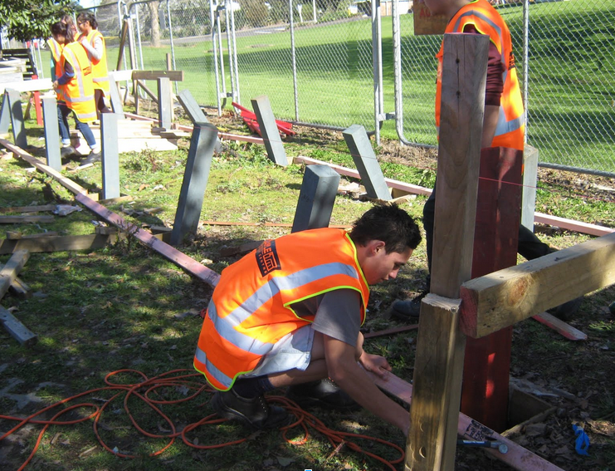
Students are being taught by tutors with a deep understanding of the subject and a passion for it as a vocation.
Why is the programme effective

Slide 10
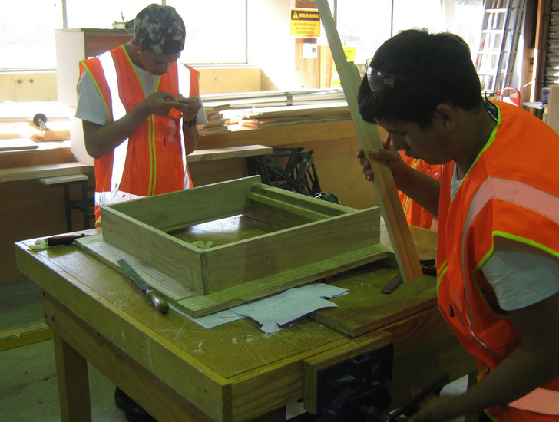
The environment is challenging and new

Slide 11
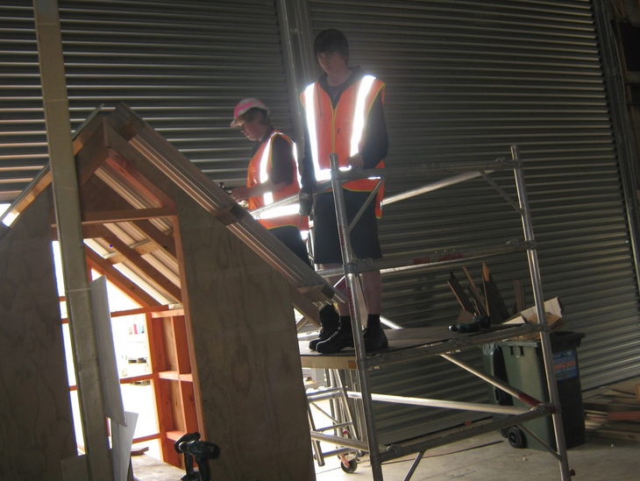
Constructing a building was a strong engagement and motivational factor

Slide 12
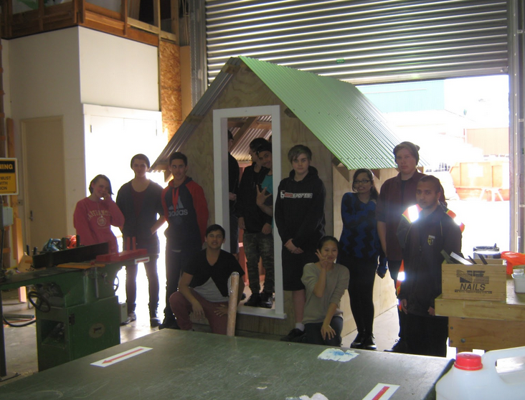
“If the education of a young person were to be a musical composition it would have many
transitions in it which assist the flow, shape and beauty of the music rather than one in which
the piece is brought to an abrupt and sudden end”
Transitions ;Discussion Paper
By Stuart Middleton
Director External Relations
Manukau Institute of Technology

